Slide 1
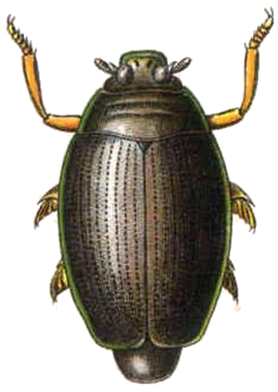
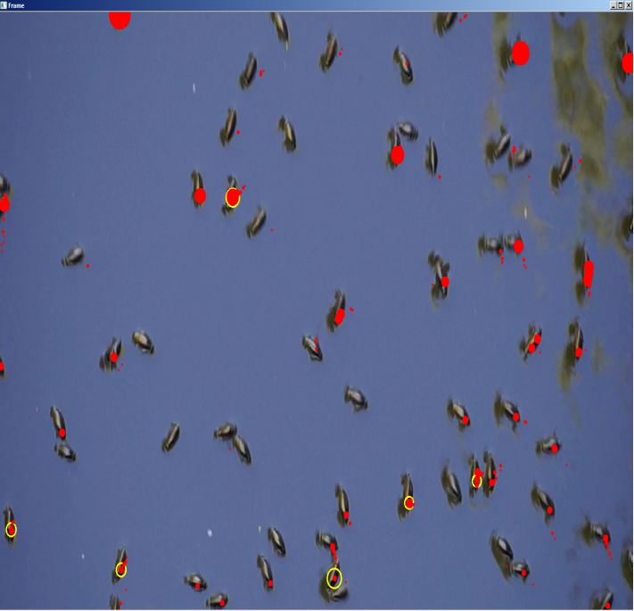
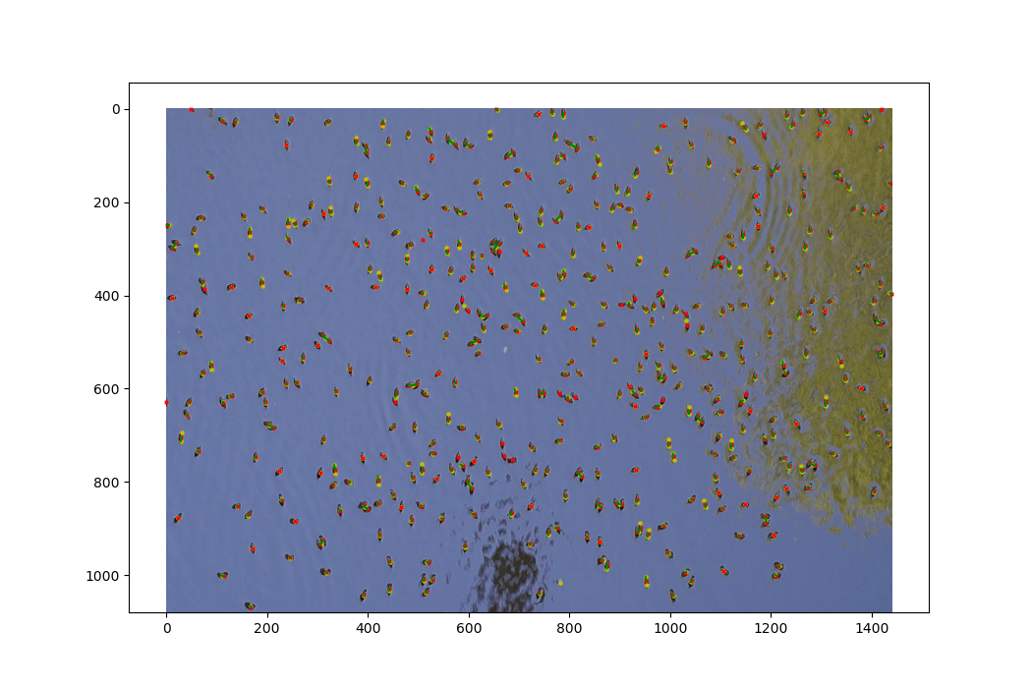
Project Whirligig
Before Filtering
After Filtering
Object Detection/Tracking
Single Frame/Multi Frame
Open CV
Modeling
NetLogo
Neural Network
TensorFlow

Slide 2
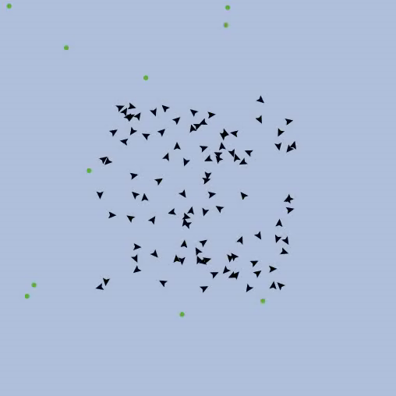
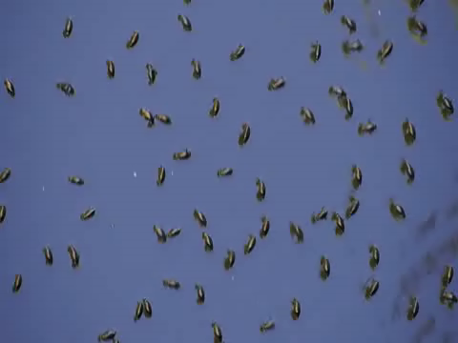
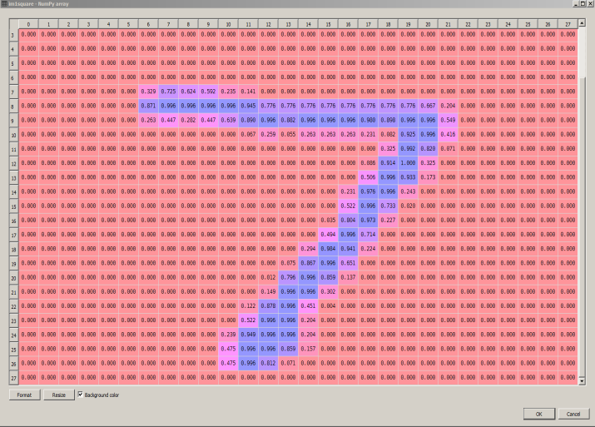
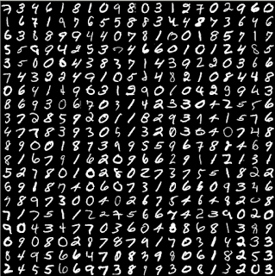
Project Whirligig
Computer simulation using NetLogo
Artificial Neural Networks

